Slide 1
CSP571 Data Preparation and Analysis
Lecture 6. Data Vizualization
Oleksandr Narykov
onarykov@iit.edu

Slide 2
Midterm Exam
Date: Oct 8th, Tuesday
Format: In-person or Virtual
Last lecture covered: Sep 31st

Slide 3
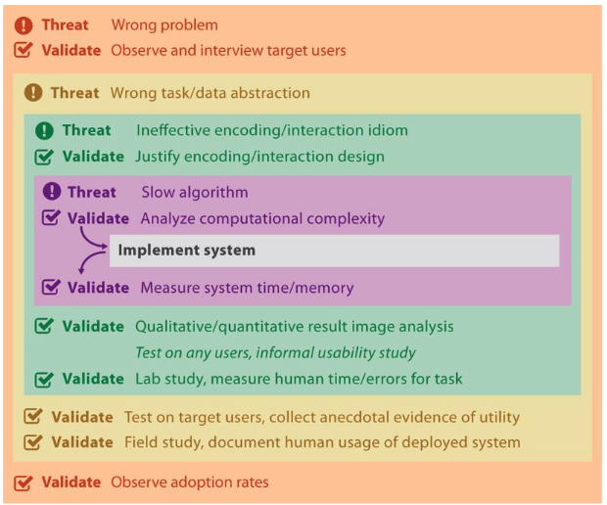
How to Validate?

Slide 4
Marks and Channels

Slide 5
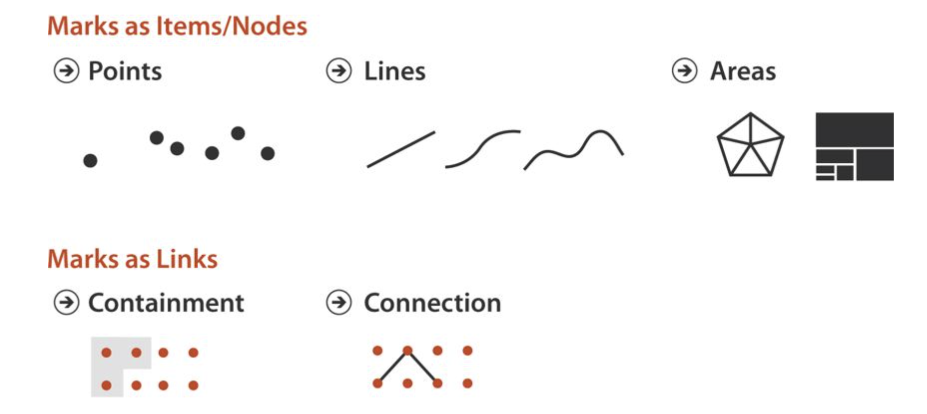
Marks

Slide 6
Marks

Slide 7
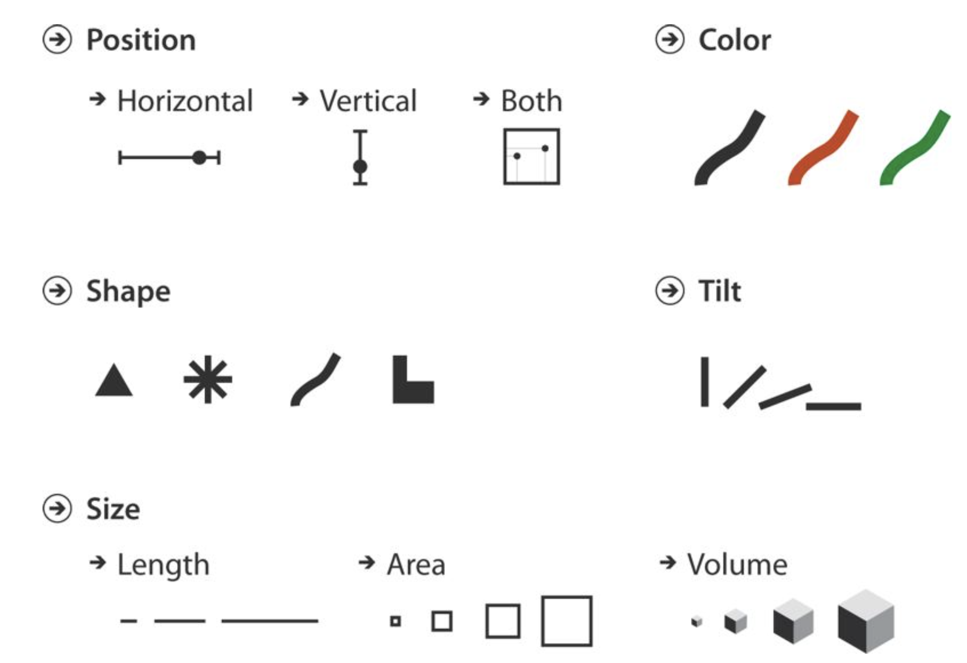
Channels

Slide 8
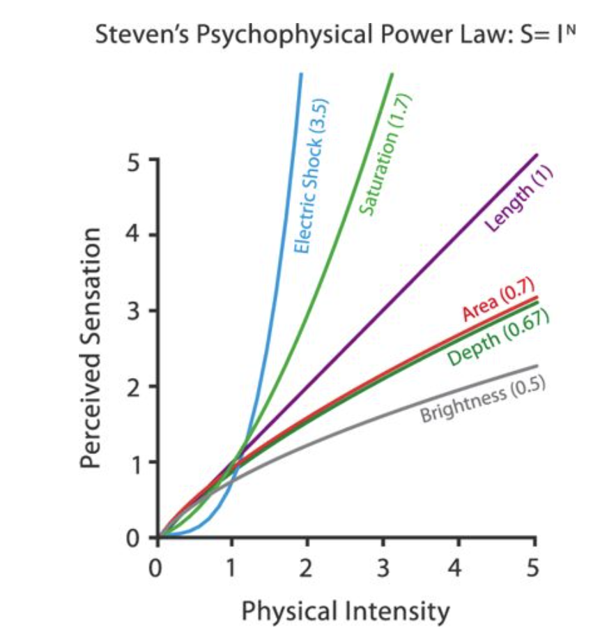
Perception Power
S. S. Stevens. Psychophysics: Introduction to Its Perceptual, Neural, and Social Prospects. Wiley, 1975. (pages 103, 104, 115)

Slide 9
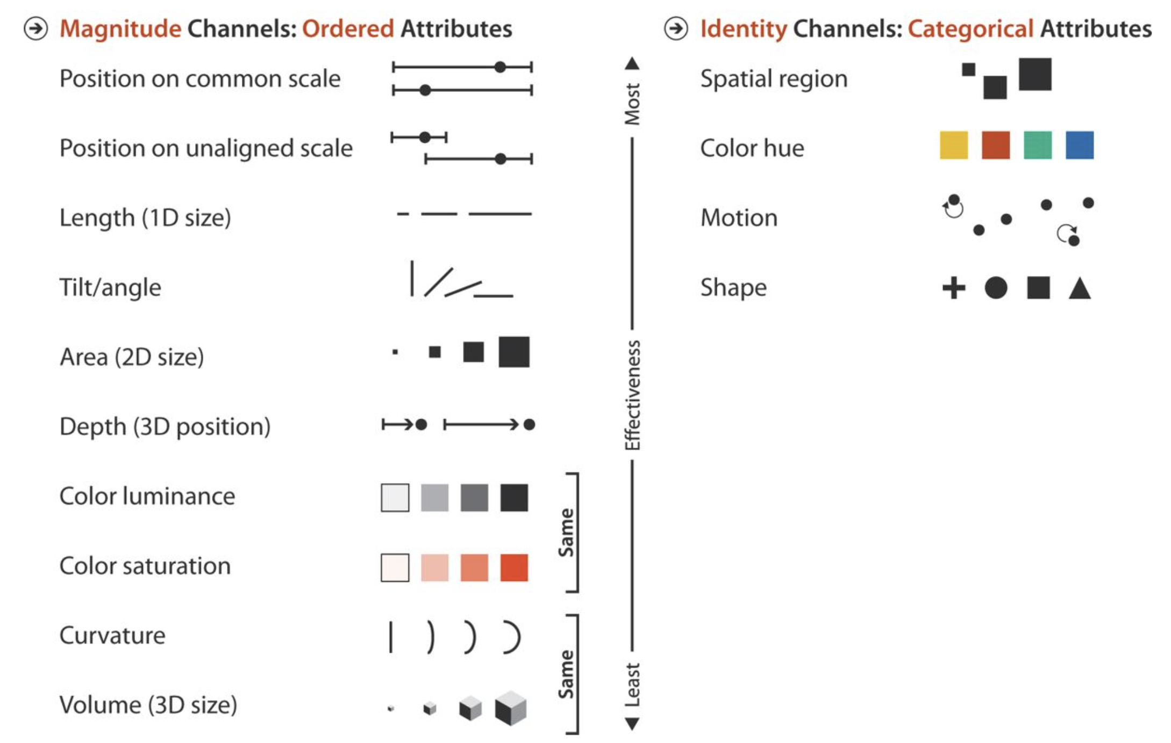
Marks and Channels

Slide 10
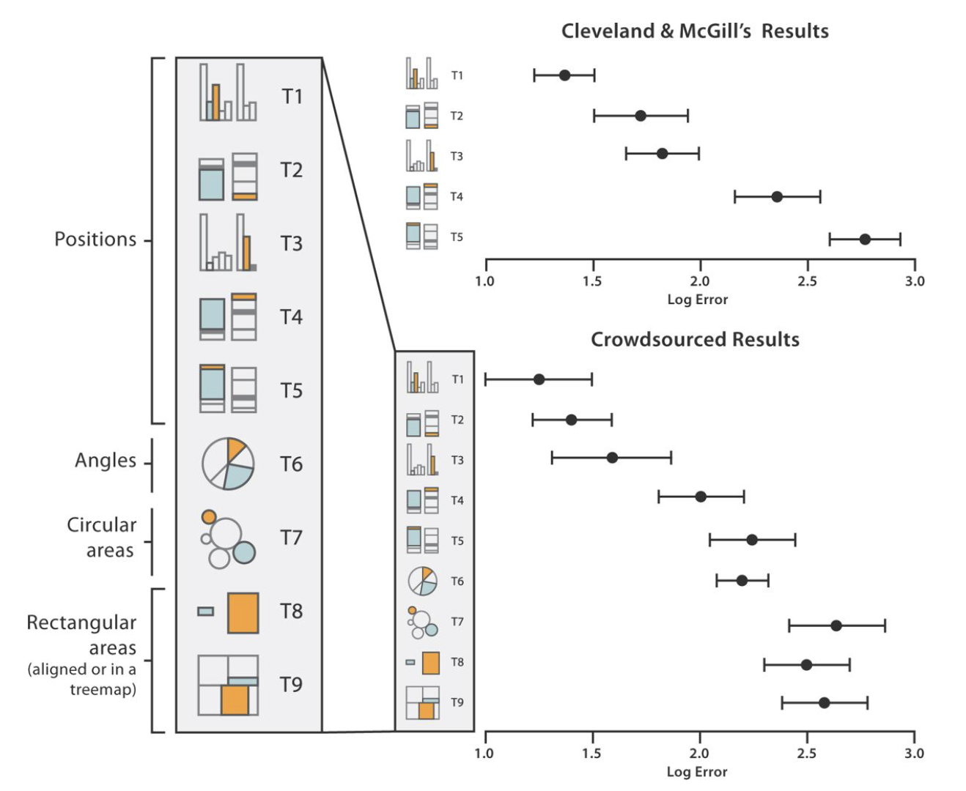
Marks and Channels. User Errors

Slide 11
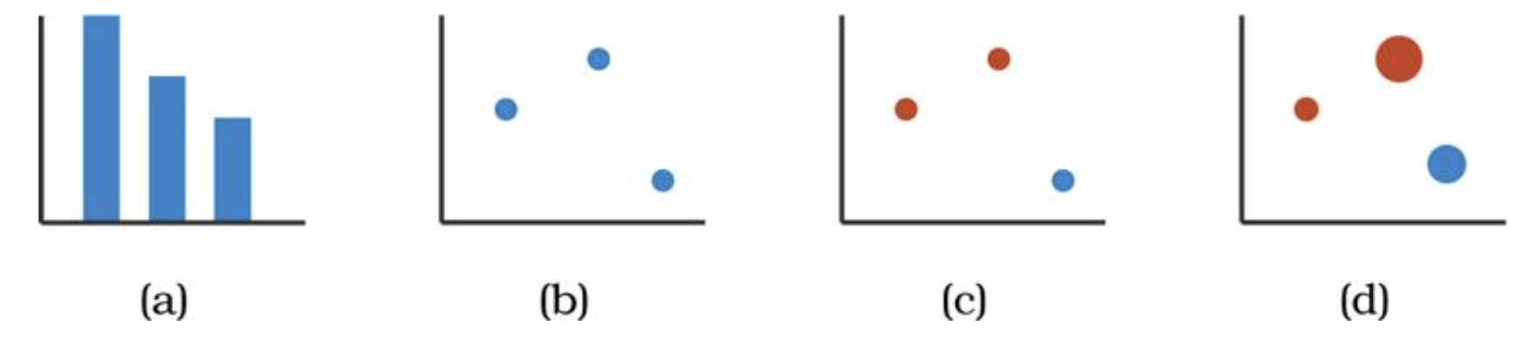
Marks and Channels Examples
Bar charts encode two attributes using a line mark with the vertical spatial position channel for the quantitative attribute, and the horizontal spatial position channel for the categorical attribute
Scatterplots encode two quantitative attributes using point marks and both vertical and horizontal spatial position
A third categorical attribute is encoded by adding color to the scatterplot
Adding the visual channel of size encodes a fourth quantitative attribute as well.

Slide 12
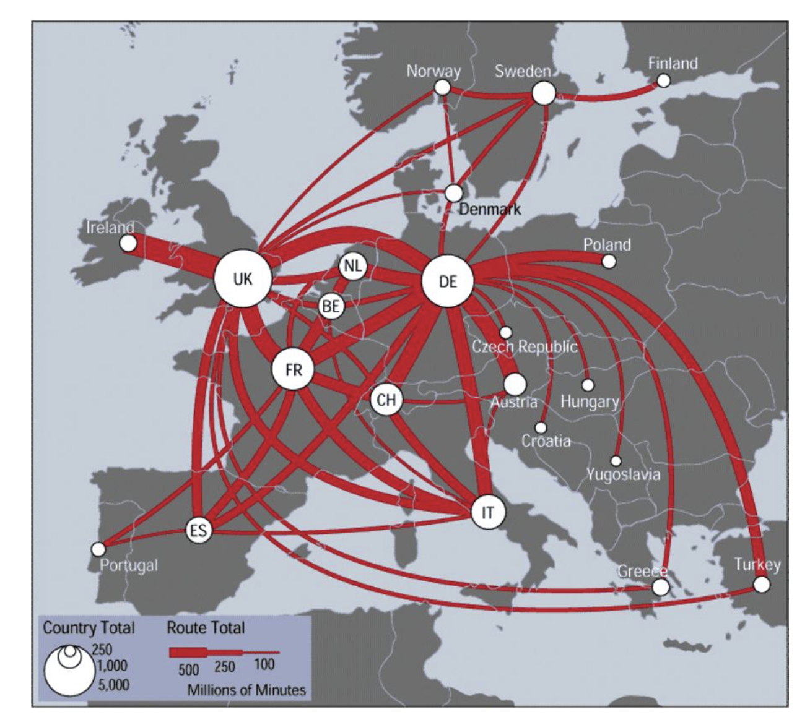
Separability

Slide 13
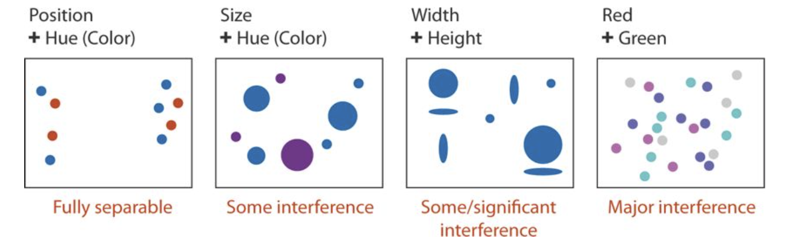
Separability

Slide 14
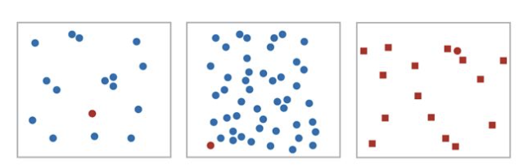
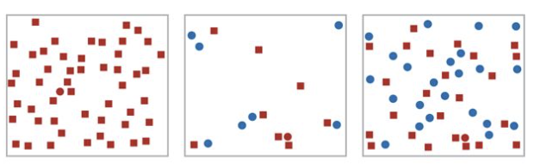

Popout

Slide 15
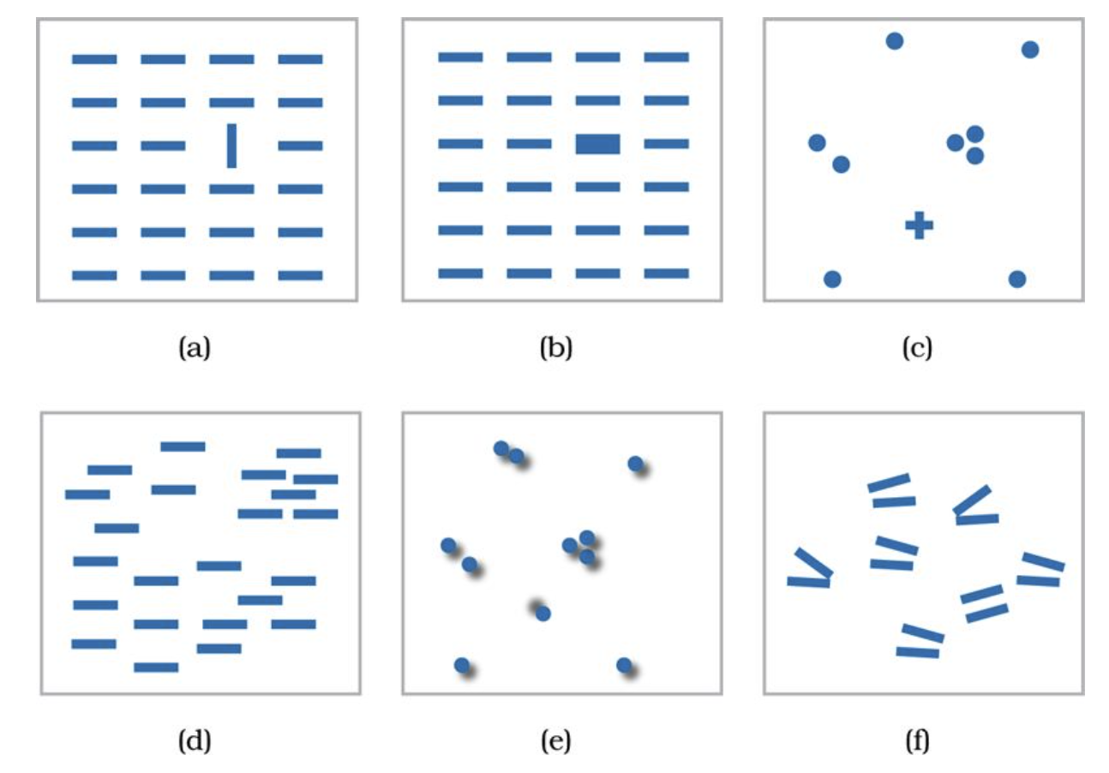

Popout

Slide 16
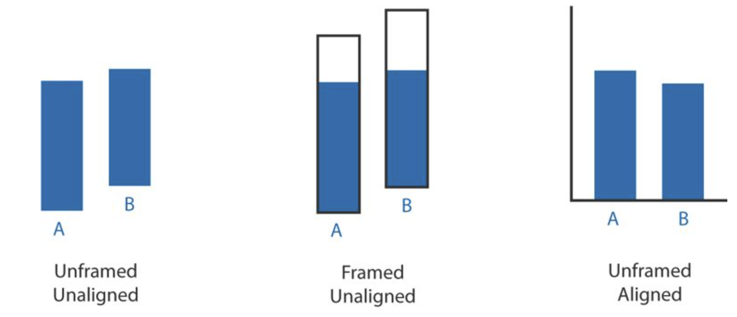
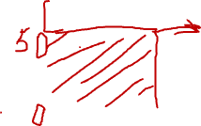
Relative vs. Absolute
Weber's Law states that we judge based on relative, not absolute differences

Slide 17
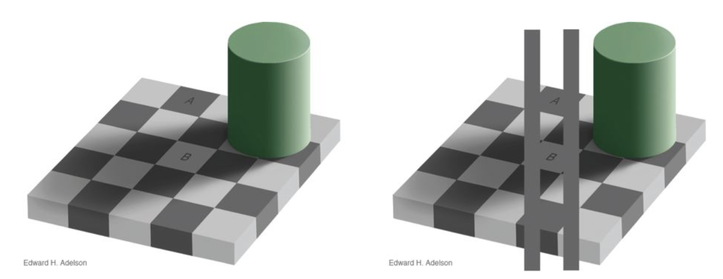
Relative vs. Absolute

Slide 18
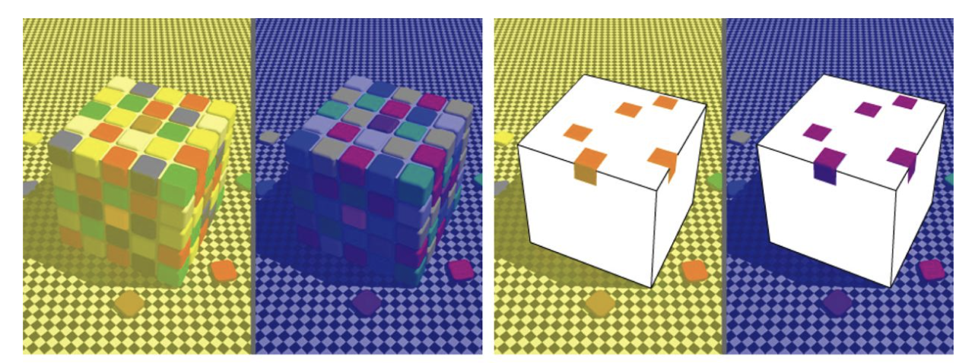

Visual Interference

Slide 19
Rules of Thumb

Slide 20
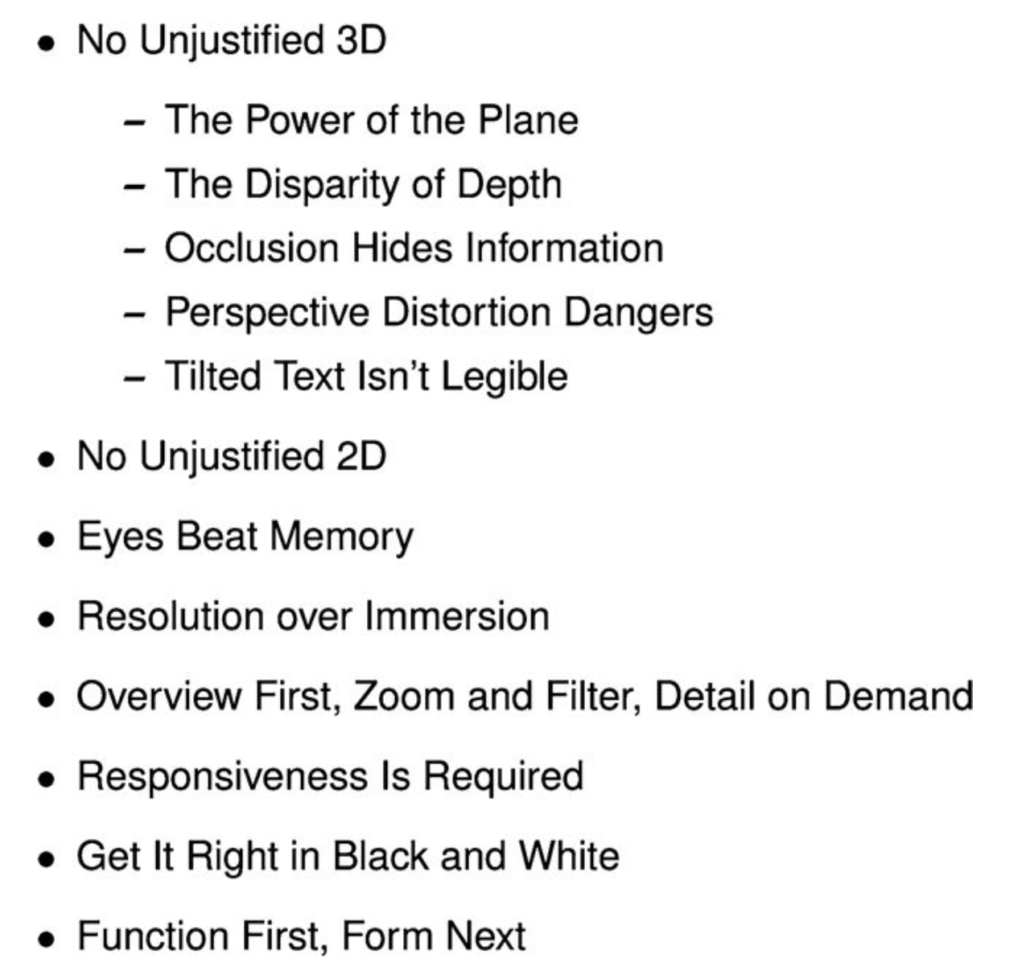
Rules of Thumb

Slide 21
Rules of Thumb

Slide 22
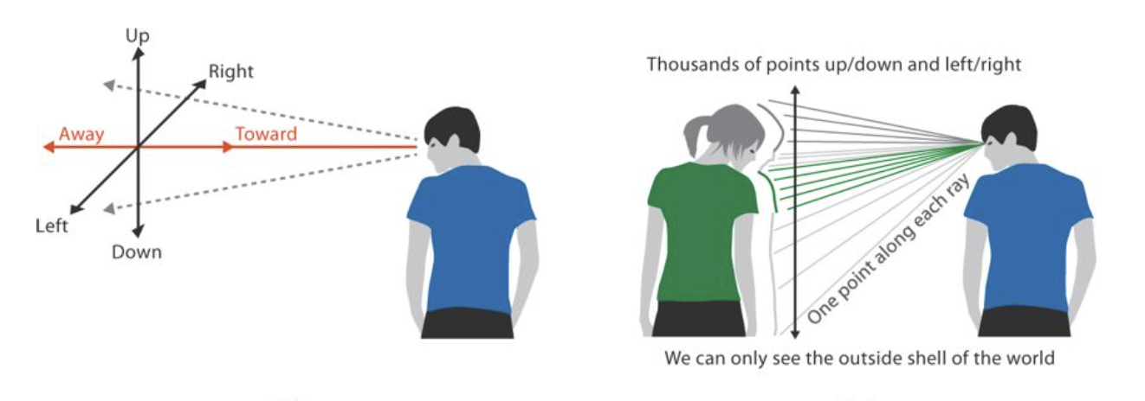
The Power of the Plane
Perception of Depth in 2D and 3D

Slide 23
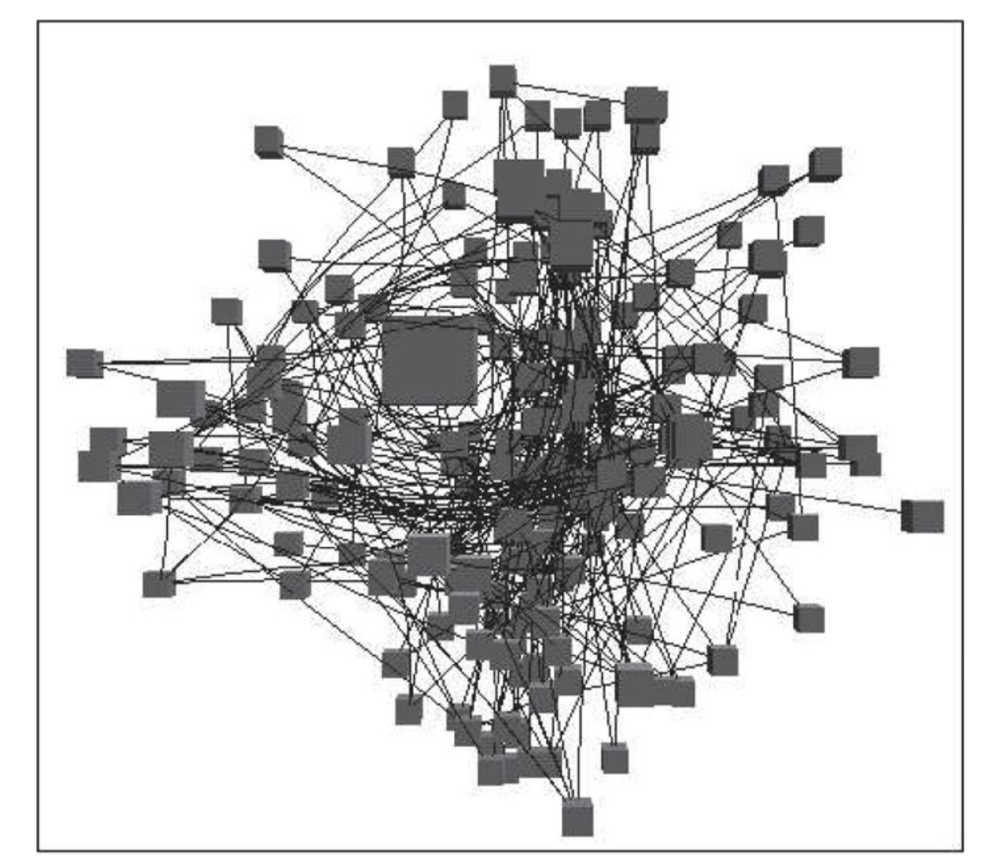
Occlusion Hides Information

Slide 24
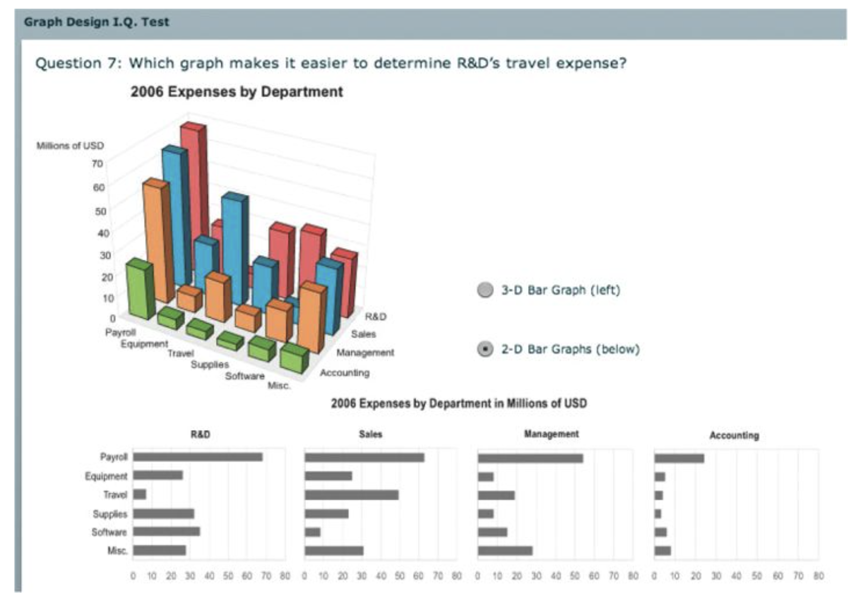

Perspective Distortion

Slide 25
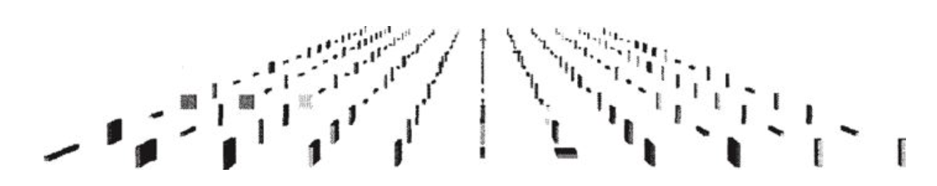

Perspective Distortion

Slide 26
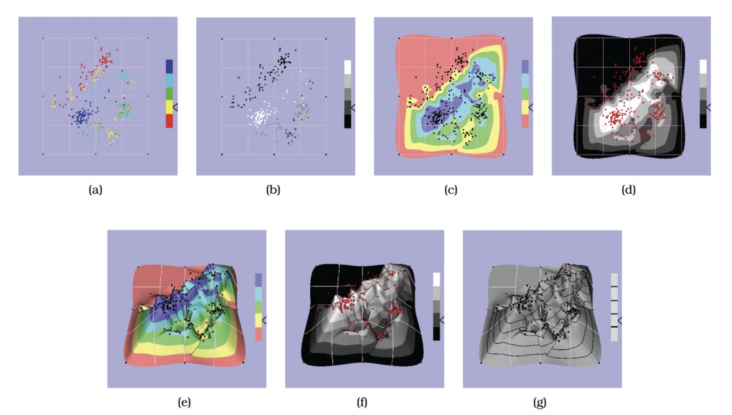
Perspective Distortion

Slide 27
Tilted Text Is Not Legible
3D is dramatically impaired text legibility with most standard graphics packages
Text fonts have been very carefully

Slide 28
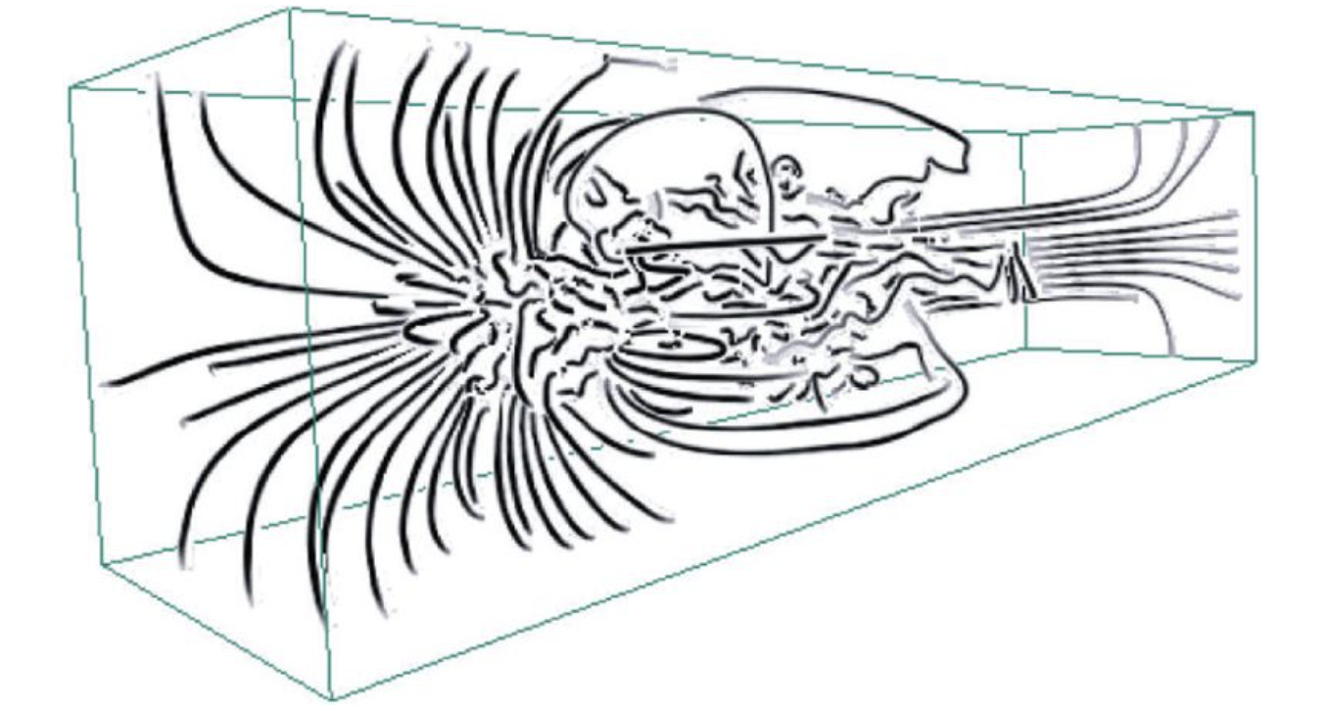
Justified 3D Usage
3D streamline showing the patterns of fluid flow through a volume

Slide 29
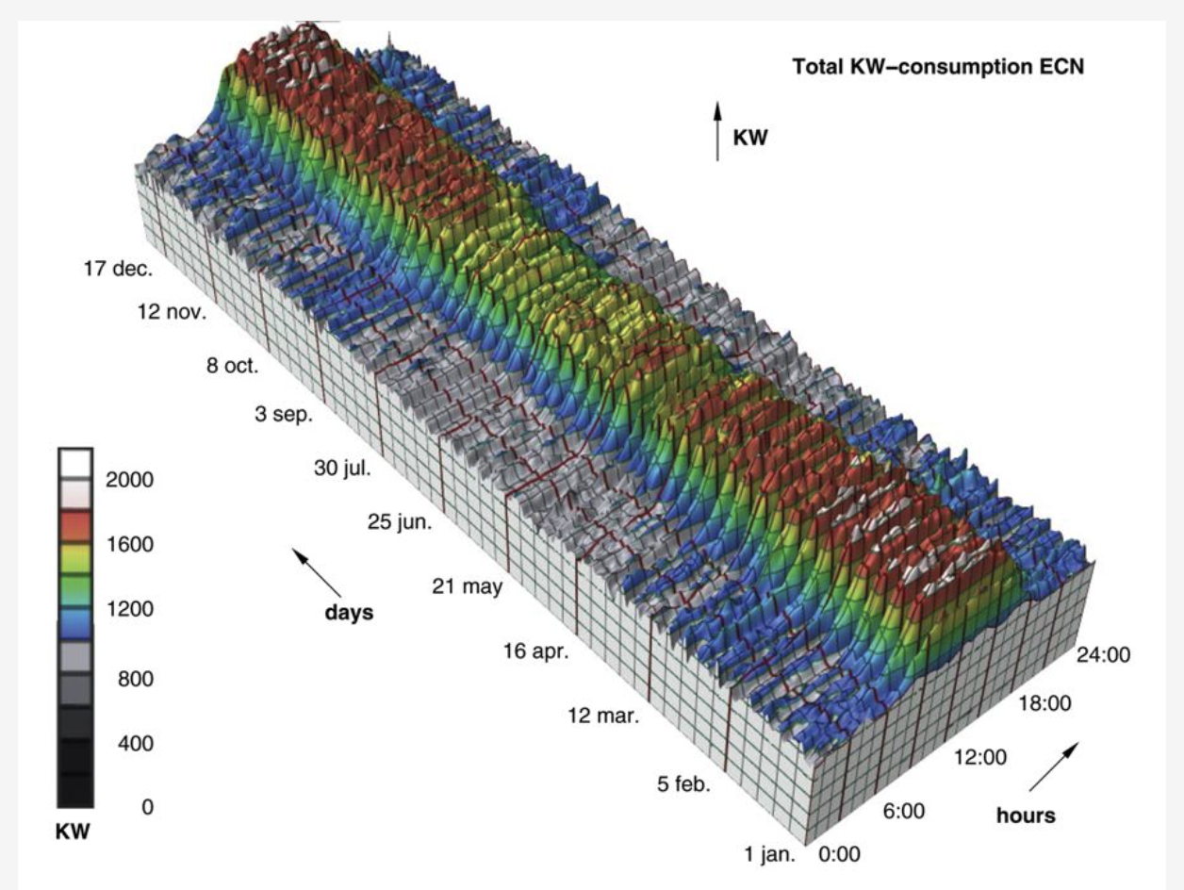
Clustering, Alignment, and Alternatives

Slide 30
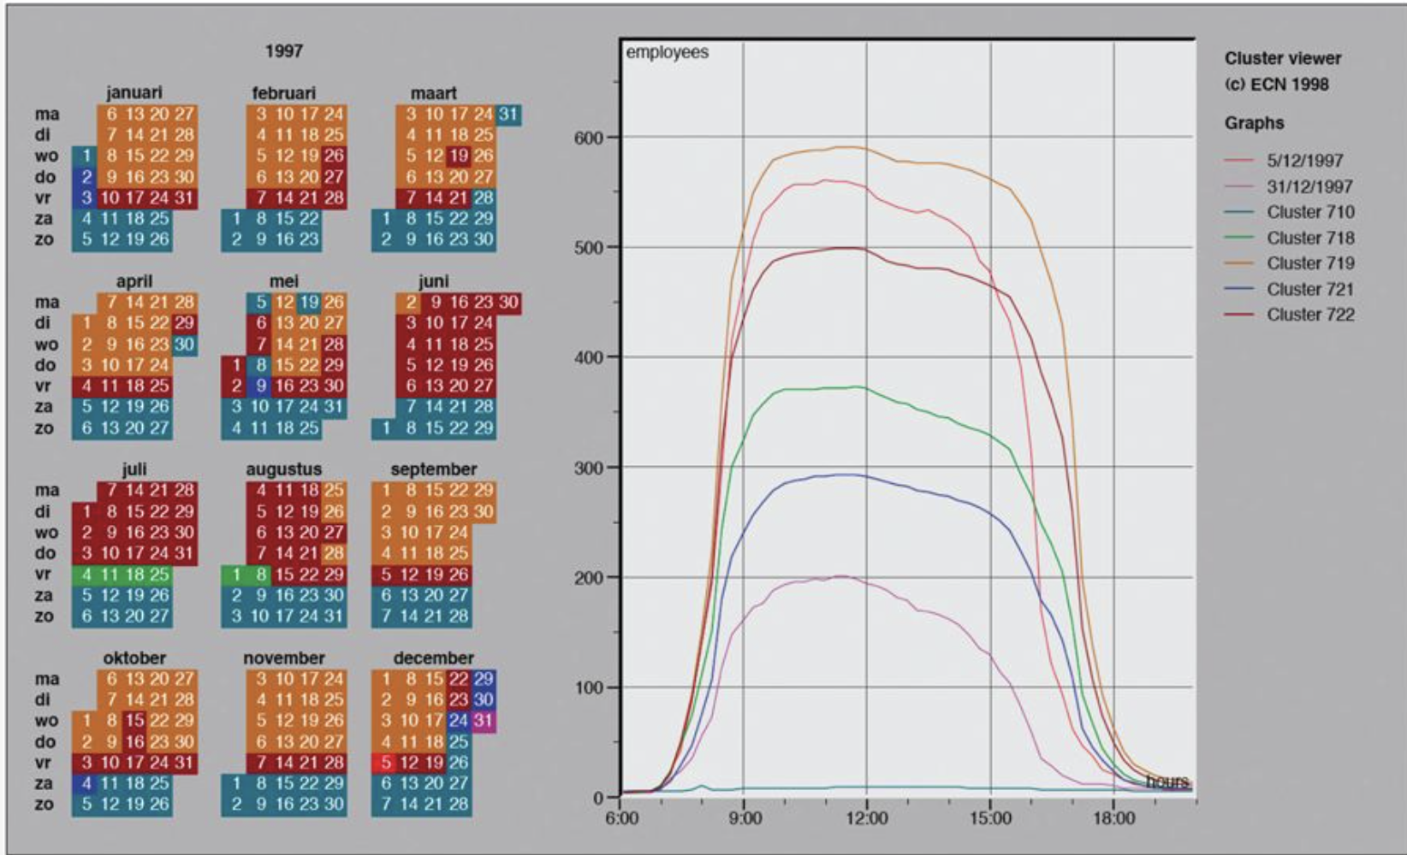
Clustering, Alignment, and Alternatives

Slide 31
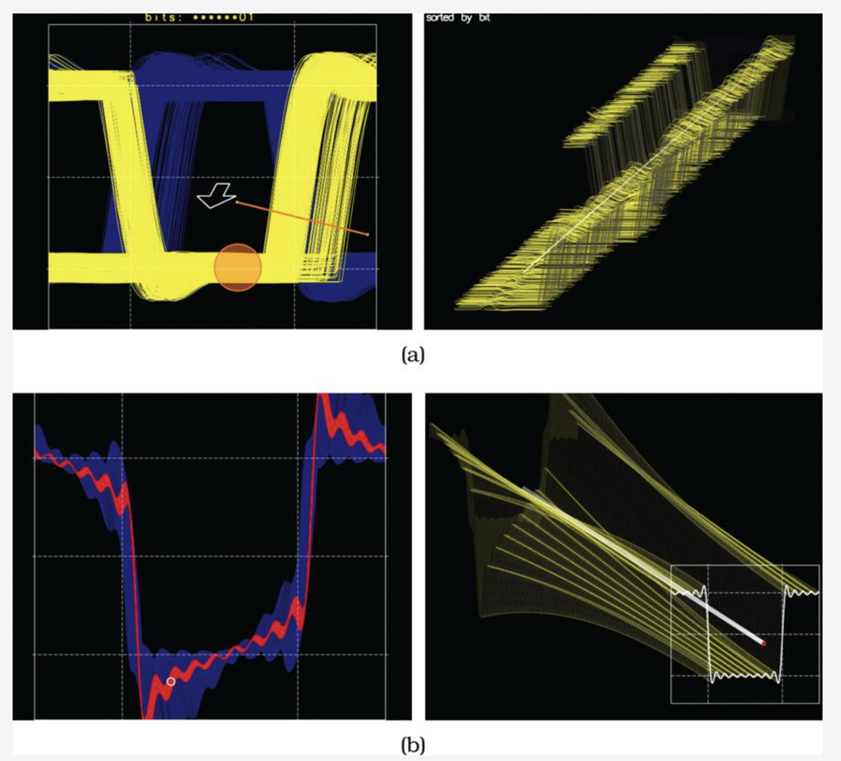
Clustering, Alignment, and Alternatives

Slide 32
Eyes Beat Memory
https://youtu.be/qanJKhV6Jvw?si=fWL-Hz7nmeWPleCS

Slide 33
Eyes Beat Memory
https://youtu.be/qanJKhV6Jvw?si=fWL-Hz7nmeWPleCS
Change Blindness

Slide 34
Resolution vs. Immersion
If you are faced with a trade-off between resolution and immersion, resolution usually is far more important.
Immersive environments emphasize simulating realistic interaction and perception as closely as possible
Immersion is most useful when a sense of presence is an important aspect of the intended task

Slide 35
Overview First, Zoom and Filter, Details on Demand
Highlight the most important aspect of the data
Summarize and reduce

Slide 36
Arrange Tables

Slide 37
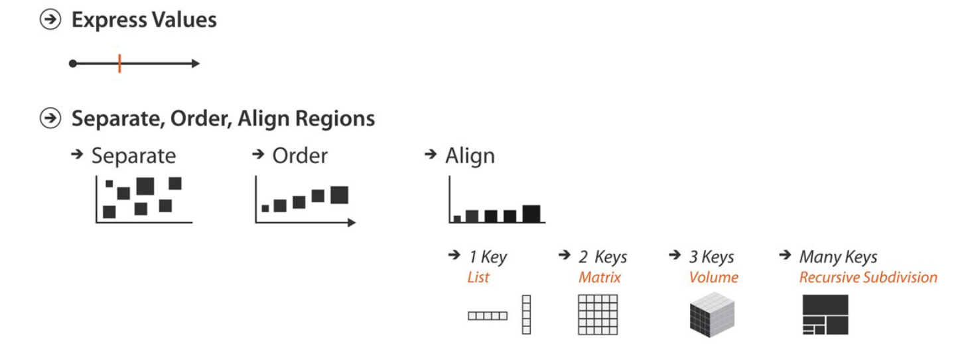
Key Points

Slide 38
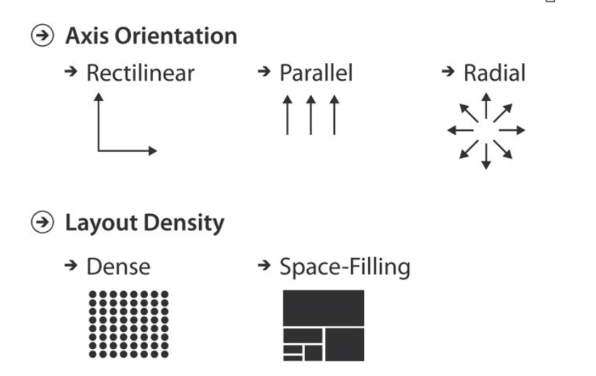
Key Points

Slide 39
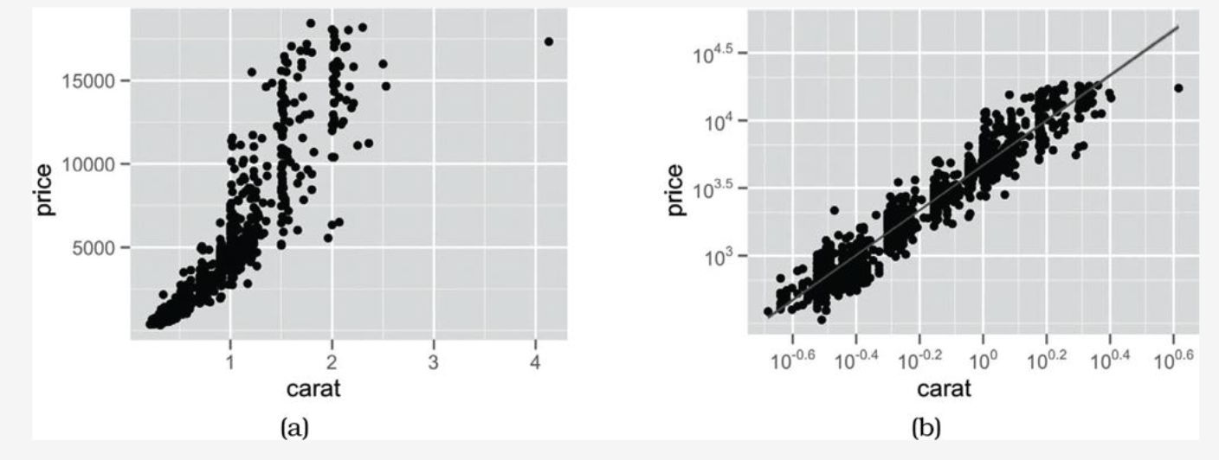
Express: Quantitative Values

Slide 40
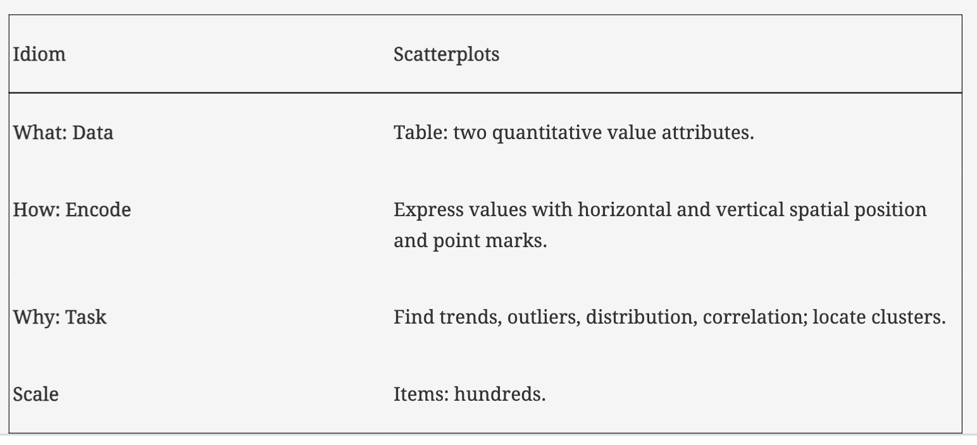
Express: Quantitative Values

Slide 41
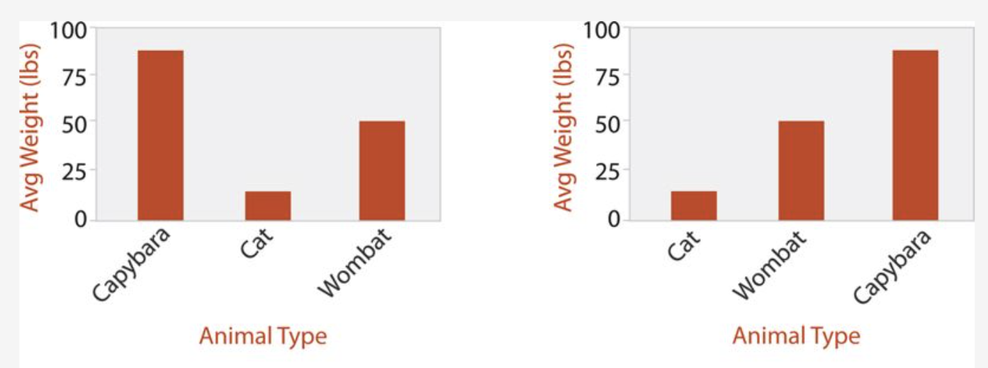
Bar Charts

Slide 42
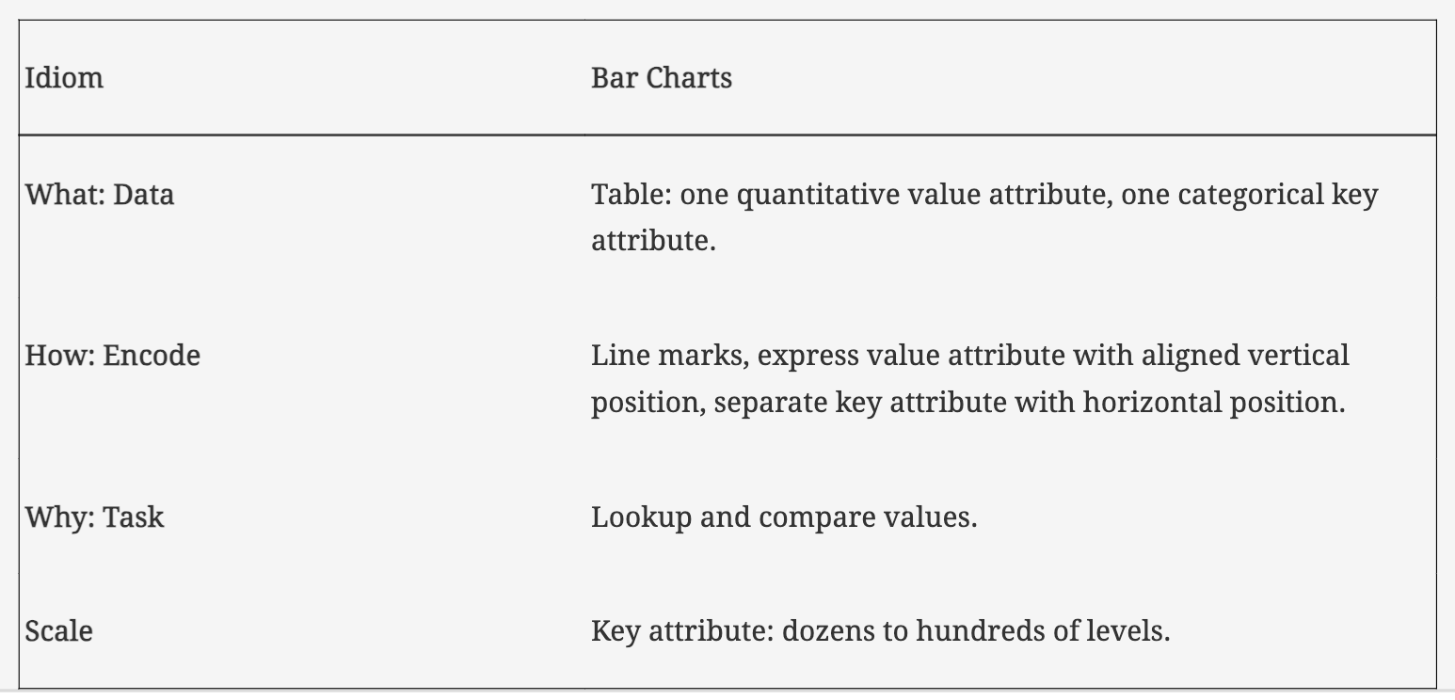
Bar Plots

Slide 43
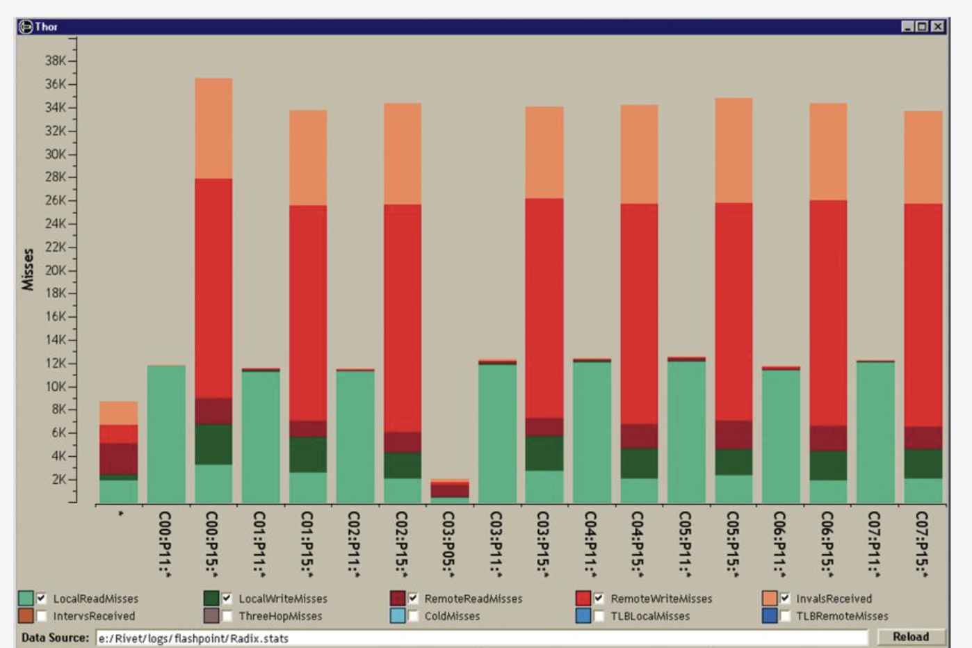
Stacked Bar Charts

Slide 44
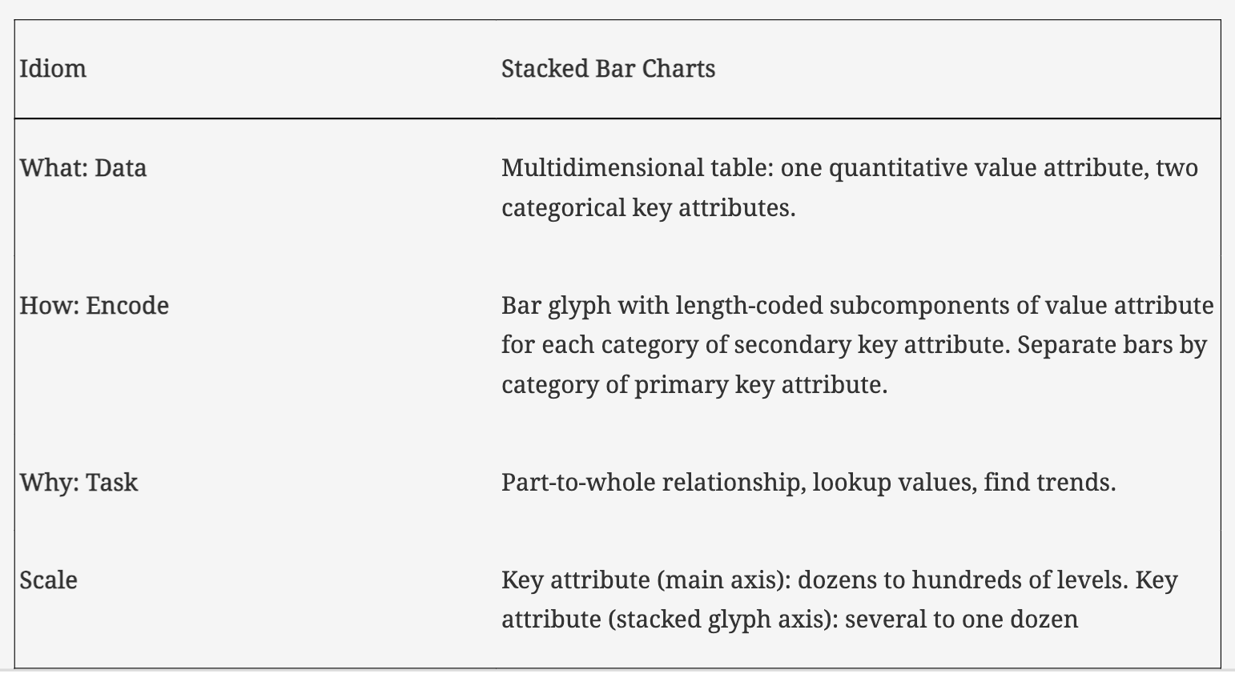
Stacked Bar Charts

Slide 45
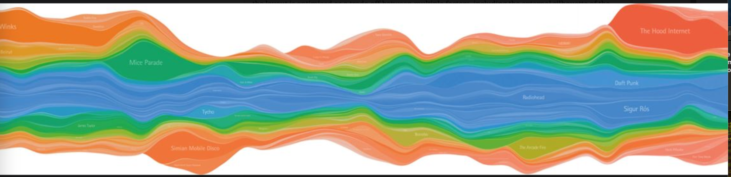
Streamgraphs

Slide 46
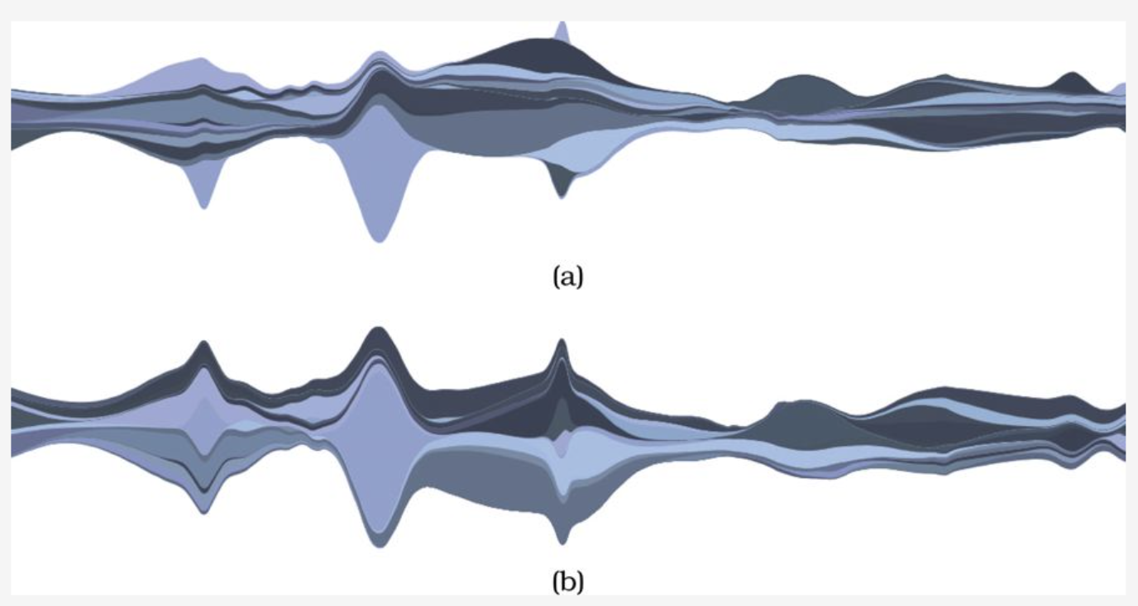
Streamgraphs

Slide 47
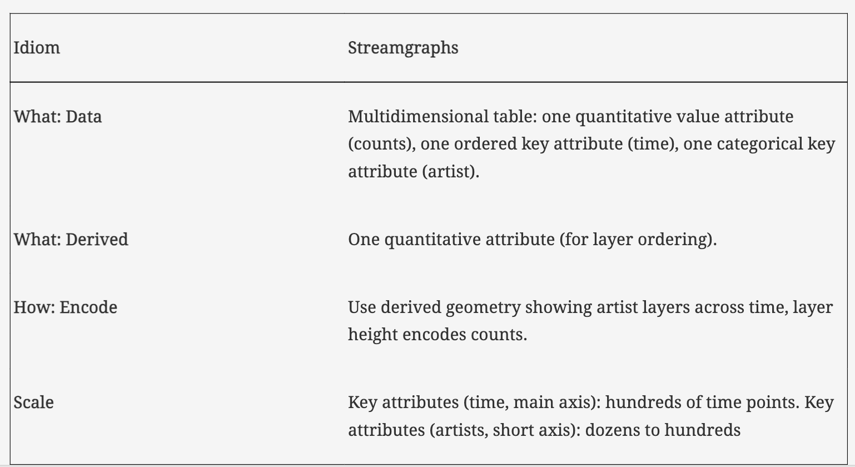
Streamgraphs

Slide 48
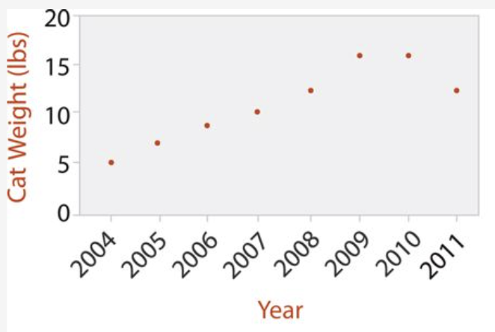
Dot Charts

Slide 49
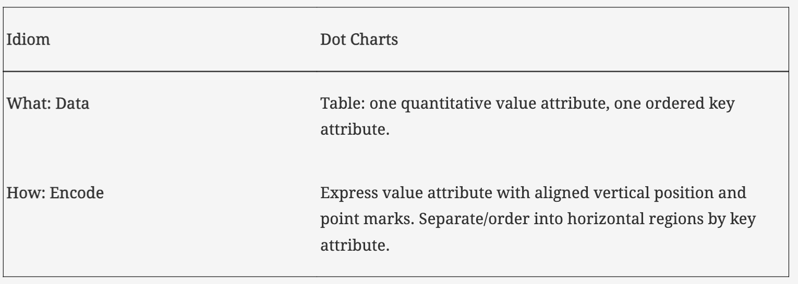
Dot Charts

Slide 50
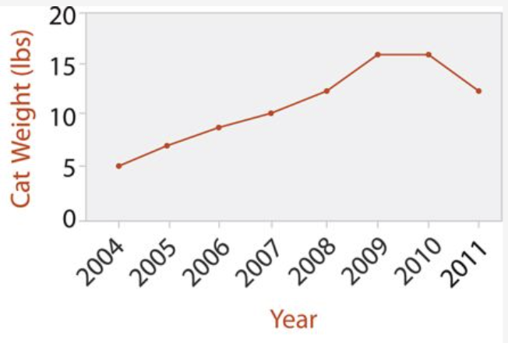
Line Charts

Slide 51
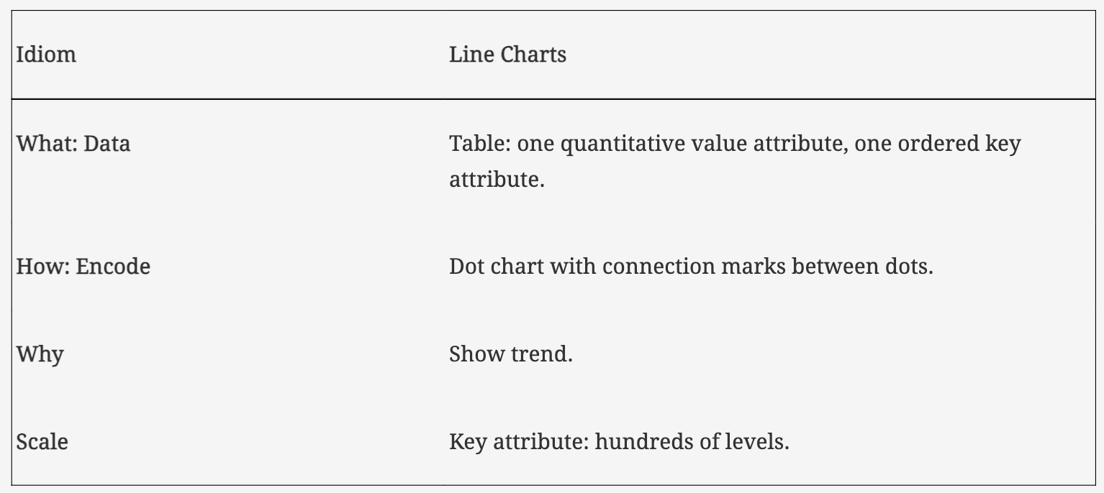
Line Charts

